Slide 1

Bachelor Of Science In Mathematics
DEPATMENT OF MATHEMATICS
GOVERNMENT ARTS AND SCIENCE COLLEGE
THENNANGUR – 604408
OCTOBER 2023

Slide 2

Subscribers Galore : Exploring World’s Top Youtube Channels
TEAM LEADER :
P.PRITHIKA
TEAM MEMBERS :
A.JEEVITHA
G.MANOGARAN
K.CHANDRU
OUR MENTOR :
MR.R.SUDHAKAR
DEPATMENT OF MATHEMATICS

Slide 3

Subscribers Galore : Exploring World’s Top Youtube Channels

Slide 4

INTRODUCTION :
"Subscribers Galore : Exploring World's Top You Tube Channels " Is A Concept That Delves Into The Most Popular And Influential You Tube Channels Across Various Genres And Topics . It Aims To Showcase The Creators Who Have Amassed A Significant Number Of Subscribers , Highlighting Their Content , Impact , And What Sets Them Apart . Whether You're Interested In Gaming , Vlogging , Education , Or Entertainment , There's A Diverse Array Of Channels That Have Captivated Audiences Worldwide . Let's Dive Into This Fascinating World Of YouTube Stardom And Discover The Channels That Have Garnered Millions Of Subscribers.

Slide 5

OVERVIEW :
"Subscribers Galore: Exploring World’s Top YouTube Channels" is a series or project dedicated to providing an in-depth overview of the most popular and successful YouTube channels worldwide .The goal of "Subscribers Galore" is to provide a comprehensive view of the YouTube landscape, celebrating the success of content creators and the impact they've had on the platform and beyond.

Slide 6

PURPOSE :
Overall, the purpose of "Subscribers Galore: Exploring World’s Top YouTube Channels" would be to inform, inspire, and entertain a wide range of audiences interested in the world of YouTube and online content creation.

Slide 7
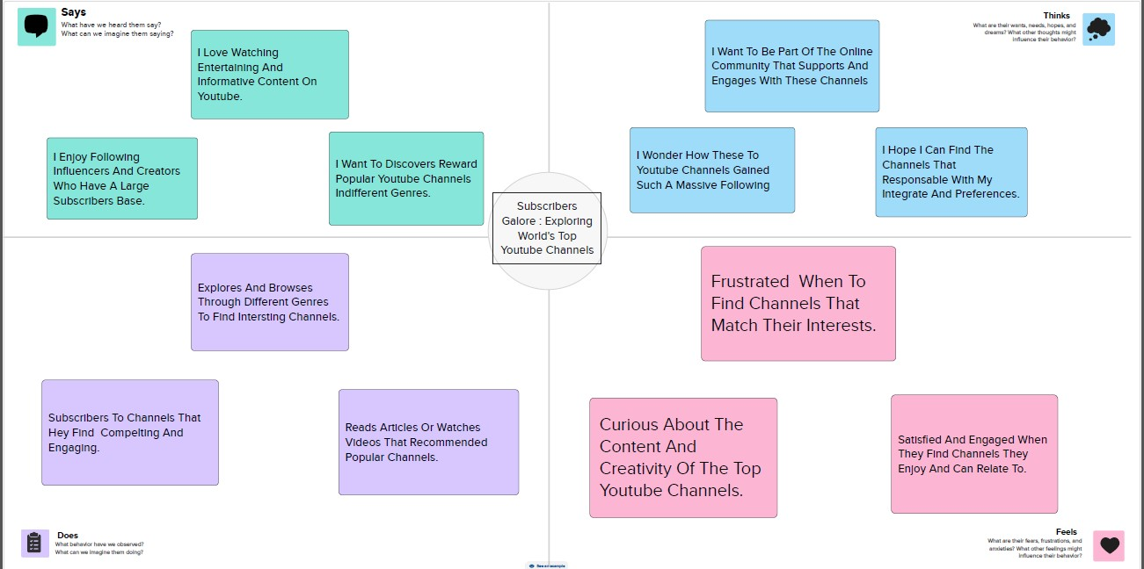

Slide 8
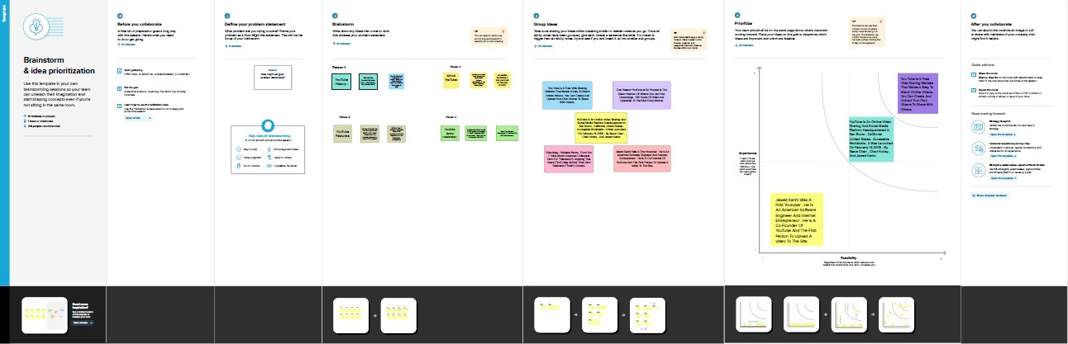

Slide 9
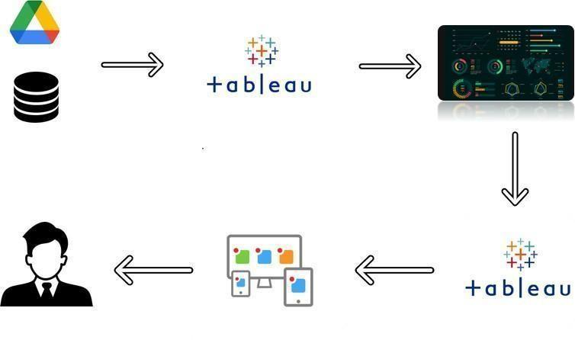

Slide 10

VISUALISATIONS :

Slide 11
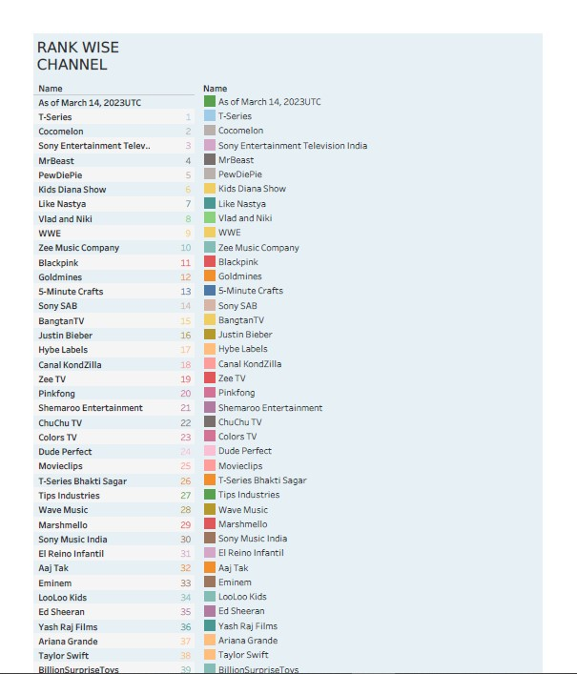

Slide 12
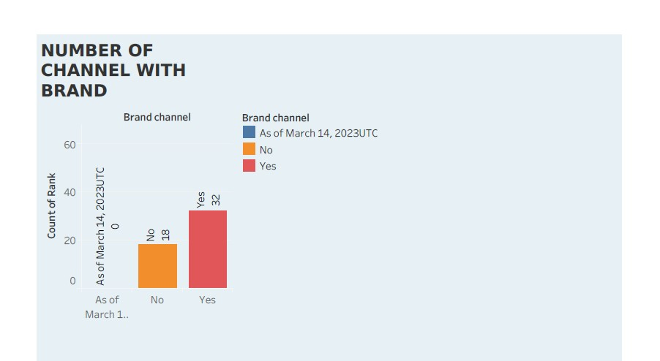

Slide 13
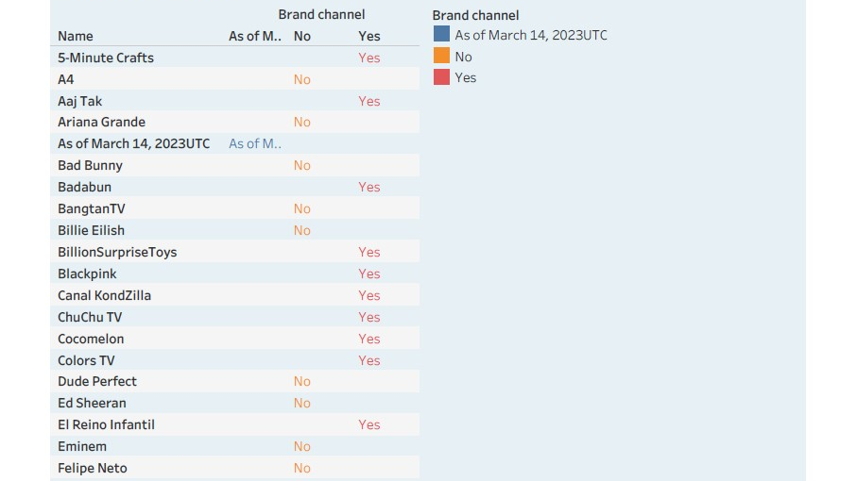

Slide 14
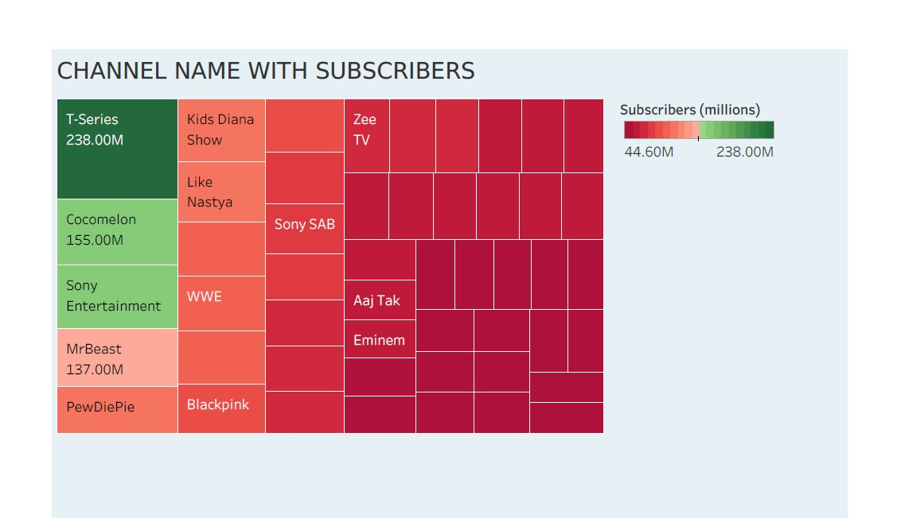

Slide 15
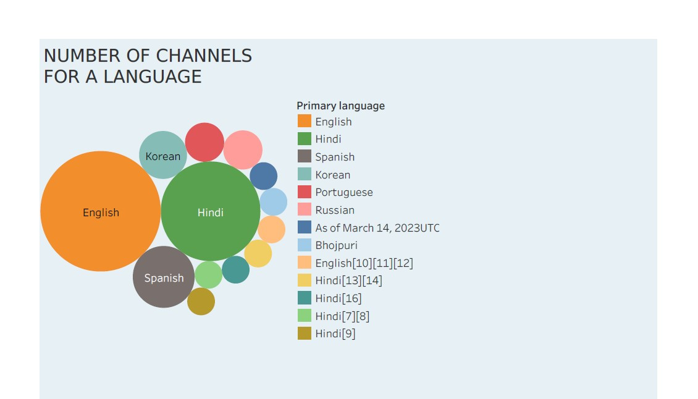

Slide 16
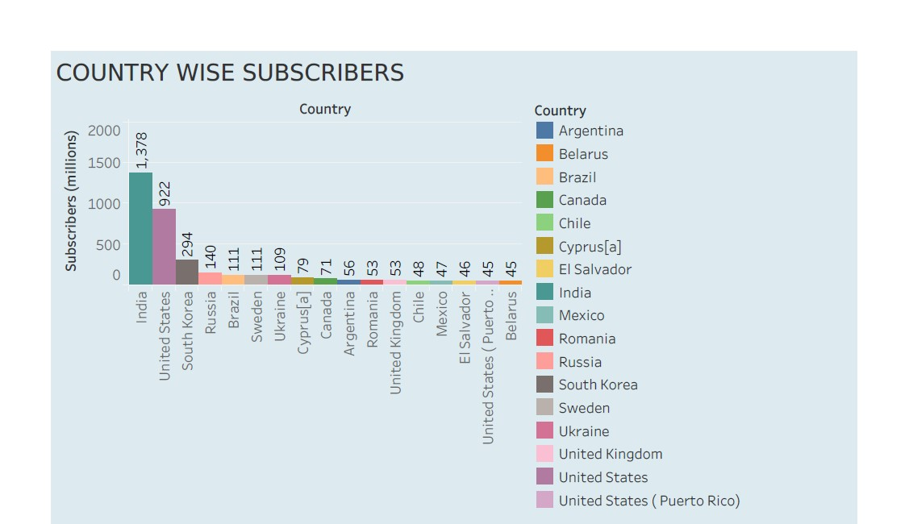

Slide 17
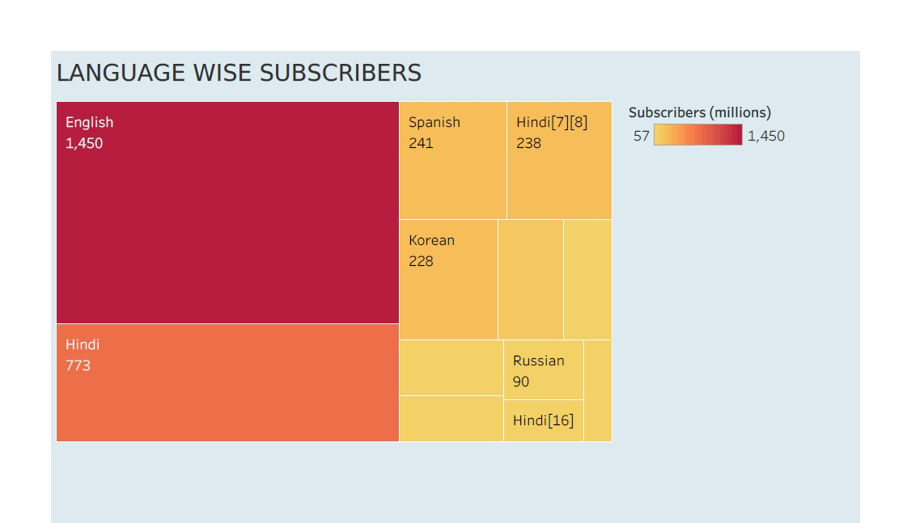

Slide 18
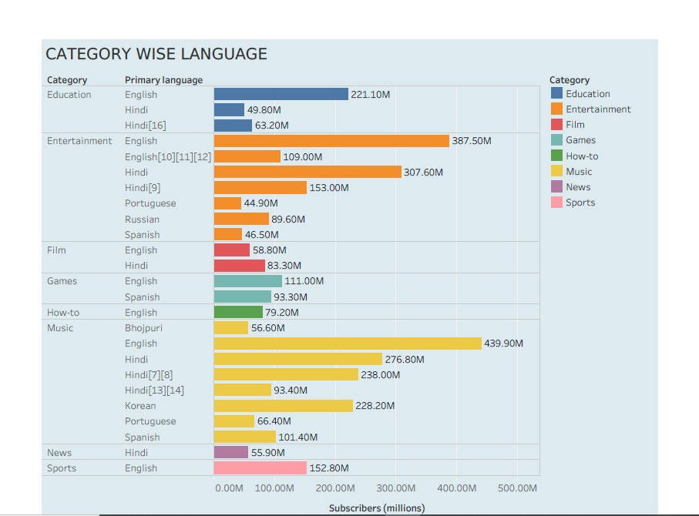

Slide 19
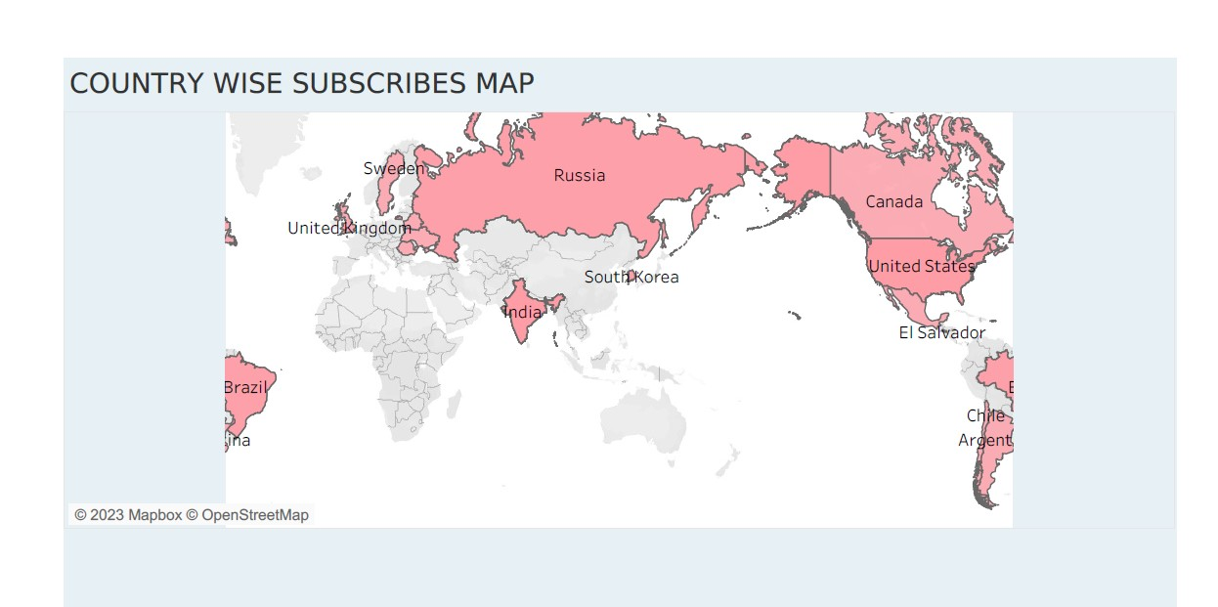

Slide 20
DASHBOARDS

Slide 21
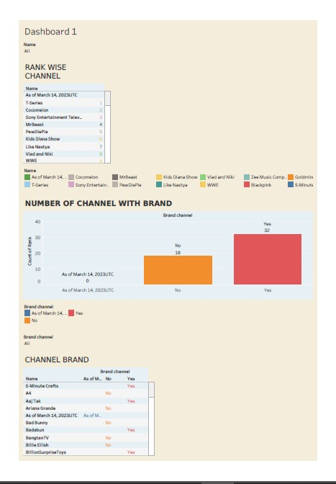

Slide 22
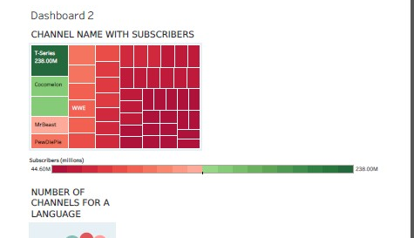

Slide 23
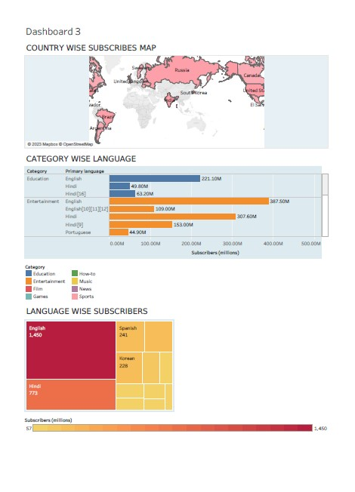

Slide 24

STORY

Slide 25
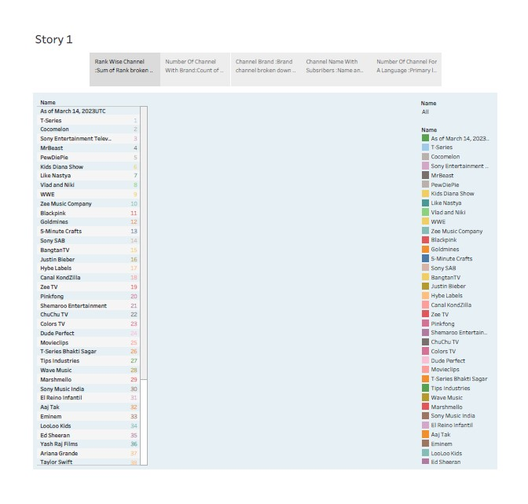

Slide 26
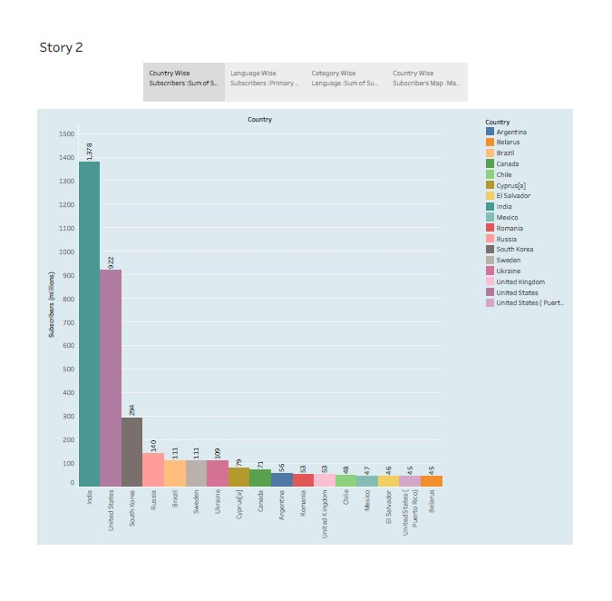

Slide 27
Advantages :
Disadvantages :
1. Insightful Content: Provides valuable insights into the world's top YouTube channels, their content, and their strategies, which can benefit both creators and viewers.
2. Inspiration: Showcases success stories that inspire aspiring YouTubers to pursue their passions and create engaging content.
3. Diversity: Highlights the vast array of content available on YouTube, promoting inclusivity and introducing audiences to various genres and interests.
4. Entertainment: Offers entertaining content for viewers interested in discovering new YouTube channels and engaging with popular creators.
1. Subjectivity: Evaluating and ranking channels can be subjective, as personal preferences vary, and what's "top" for one person may not be the same for another.
2. Limited Scope: It may not cover all deserving channels, potentially leaving out some excellent content creators.
3. Changing Landscape: YouTube is dynamic, and the popularity of channels can change rapidly, making it challenging to keep information up to date.
4. Overlooked Smaller Channels: Focusing on top channels might overshadow smaller, high-quality channels that deserve recognition.

Slide 28

APPLICATIONS :
"Subscribers Galore" can be a versatile and informative resource for a wide range of individuals, from YouTube enthusiasts to researchers and marketers, while contributing to the growth and development of the YouTube platform

Slide 29

CONCLUSION :
"Subscribers Galore: Exploring World’s Top YouTube Channels" is an engaging project that offers both advantages and disadvantages. It serves as a valuable platform for celebrating content creators, providing insights, and inspiring both viewers and aspiring YouTubers. The project highlights the diverse array of content on YouTube and educates its audience about the evolving landscape of the platform.

Slide 30

FUTURE SCOPE :
Subscribers Galore" lies in its ability to adapt to the evolving digital landscape, staying relevant and offering valuable insights to its audience, while continuing to celebrate and support the YouTube community.

Slide 31

THANK YOU

